Slide 1
（Track 6 On-vehicle smartphone）
WHU&AutoNavi: Smartphone-based Vehicle Positioning Algorithm Design for IPIN-2020 Competition
(TRACK 6)
Team Members:
Jian Kuang, Wenfei Ge, Zhi Dou,
Aipeng Tang, Xiaobing Zhang
Reporter:
Jian Kuang
GNSS Research Center, Wuhan University
December 14th, 2020

Slide 2
General scheme

Slide 3
Strap-down Inertial navigation algorithm
Due to the low accuracy of the built-in sensor on the mobile phone, the influence of angular rate and sculling effect caused by the rotation of the earth and motion speed can be ignored.
The bias and noise parameters of the gyroscope and accelerometer are adjusted according to the three sets of training data given by the competition.

Slide 4
Extended Kalman Filter
Error State
Position
Velocity
Attitude
Gyros Bias
Acc Bias
Lever Arm
State transition:

Slide 5
ZUPT&ZARU
Zero-velocity update technology (ZUPT) is a very effective means to control the accumulation errors of velocity. The raw output of IMU is used to determine the motion state of vehicle. When the vehicle is detected to be stationary for one second, the virtual velocity observation of zero is employed to update the navigation state.
Observation equation:

Slide 6
ZUPT&ZARU
At the same time, zero angle rate update (ZARU) is used for controlling heading error. The basic idea is the heading of the vehicle should remain unchanged. All heading error can be considered to be caused by sensor error.
Observation equation:

Slide 7
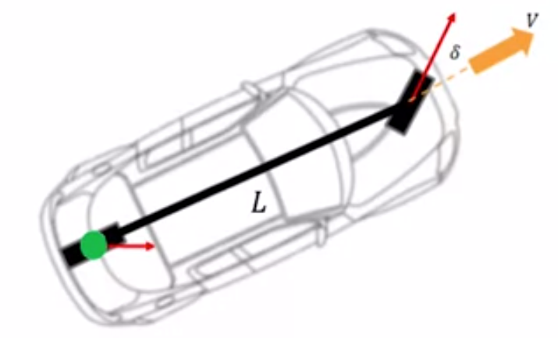
Motion Constraint Model
The basic concept is that the vehicle rarely jumps and slides, so it can be considered that the lateral and vertical speeds in the vehicle frame are zero.
The misalignment angle between the smartphone frame and the vehicle frame can be determined by the training data.
Since the mobile phone is installed in the front of the vehicle, the NHC lever arm can't be ignored, we add them to the state variables.

Slide 8
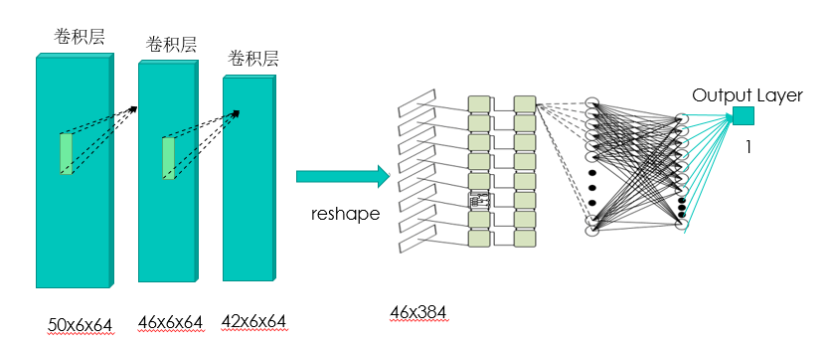
Forward speed estimation
We established a supervised machine learning model. Simple training by using training data can provide accurate estimation of the vehicle forward speed (e.g., the speed error is 0.5 m/s).

Slide 9
Velocity Observation Equation
Velocity Observation in the vehicle frame
Observation equation:

Slide 10
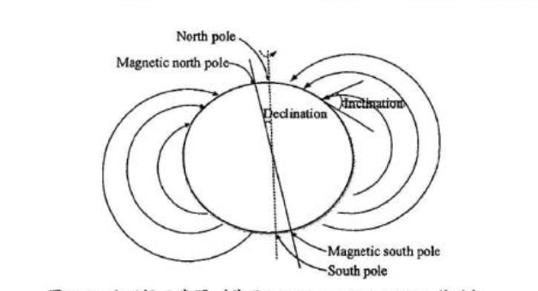
Magnetic field update
The relative heading changes calculated by the magnetometer measurement to correct the heading estimated by the INS, which can still effectively improve the accuracy of the heading estimation.
Observation equation:

Slide 11
GNSS Position Update
The GNSS position are the most important absolute information. Due to GNSS signal is easily affected by the external environment, the chi-square test to determine the reliability of the GNSS position for ensuring the stability of the filter.
Observation equation:

Slide 12
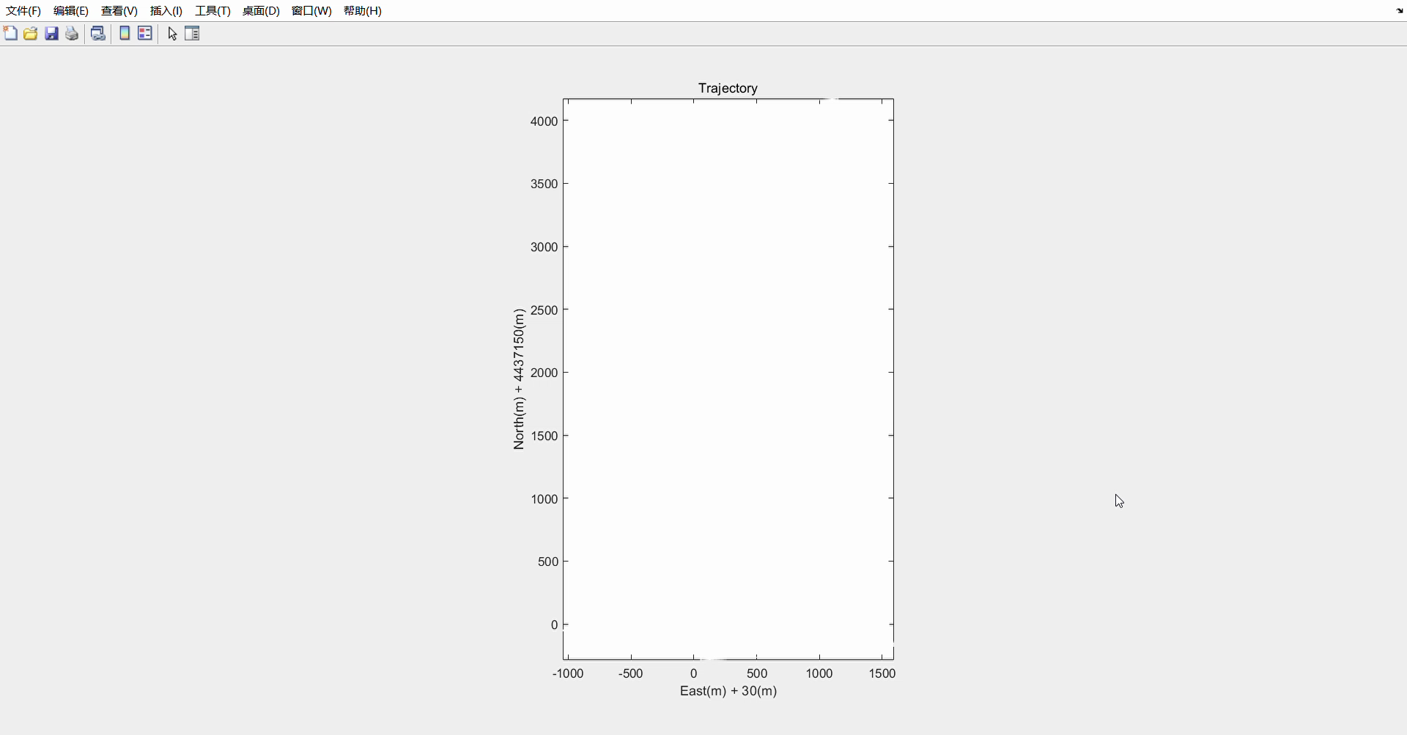
Results
the color circles means GNSS position ,the red line represents the result of our fusion localization algorithm

Slide 13
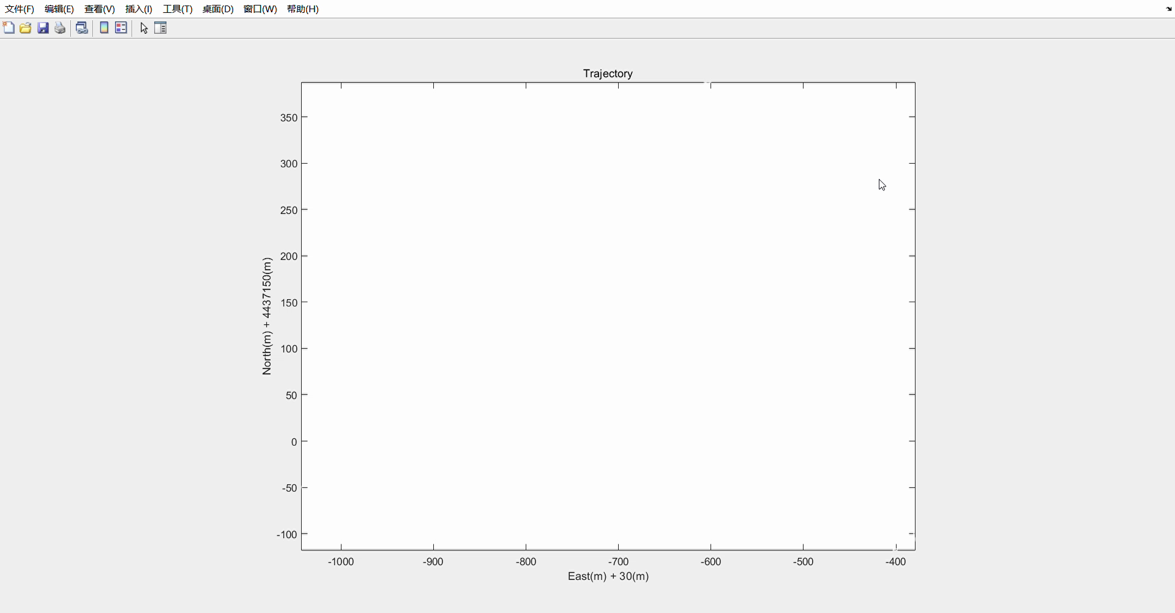
Results
the color circles means GNSS position ,the red line represents the result of our fusion localization algorithm

Slide 14
THANK YOU FOR YOUR ATTENTION！
E-mails: Jian Kuang (kuang@whu.edu.cn)

